Slide 1
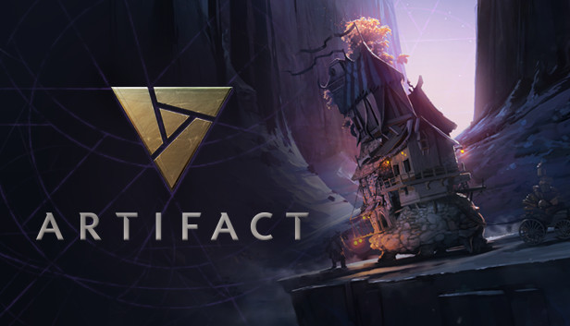
Final Project:
Artifact Market Analysis Tools
Group Members:
Atul Srivastava
Brendan Bruce
Nicholas Clegg

Slide 2
Project Proposal -> Current Project
“To perform high performance web scraping to build and maintain databases containing information that would be fun or useful for building data science reports. Data science is a field that looks to extract knowledge from large amounts of data. One of the key things needed is to have clean, useful data to work with. For our project we would like to create databases filled with data that could be used for data science reports”
Perform web scraping to build and update a database containing pricing information for the new digital Trading Card Game (TCG) Artifact.
Using the database then build visualization tools and develop automated “triggers” for interesting events.
Designed for maximum scalability and robustness against game updates.

Slide 3
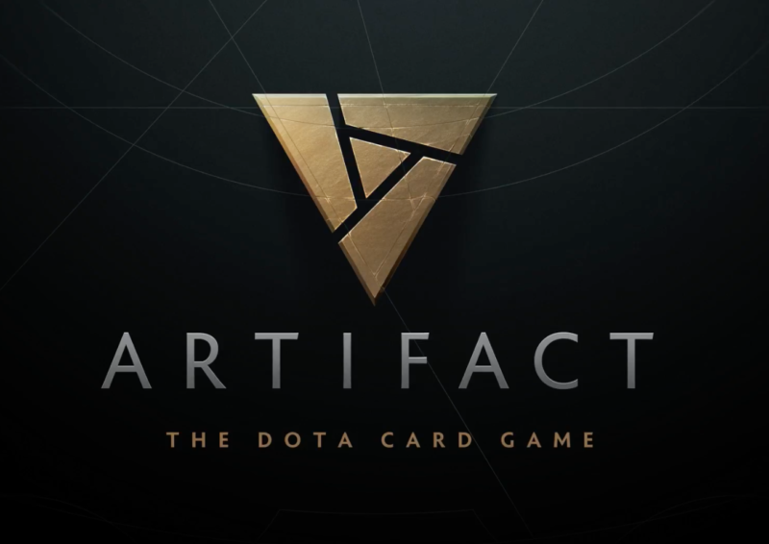
Motivations
and
History

Slide 4
Influence
for
Project
Many of our group members have a strong interest in online gaming
Our interests in this game stems from one of the more popular online card games called Artifact.

Slide 5
Artifact:
The Dota Card Game
Artifact is a new online card game based off of the very popular MOBA style games Dota and Dota 2.
This game includes a real-money marketplace where players can go and buy card to use in game.

Slide 6

History of Artifact
Artifact was designed as a competitor of Hearthstone, the most played online card game today
In order for it to be competitive, it needed to challenge many of the features Hearthstone started and attracted an audience with

Slide 7
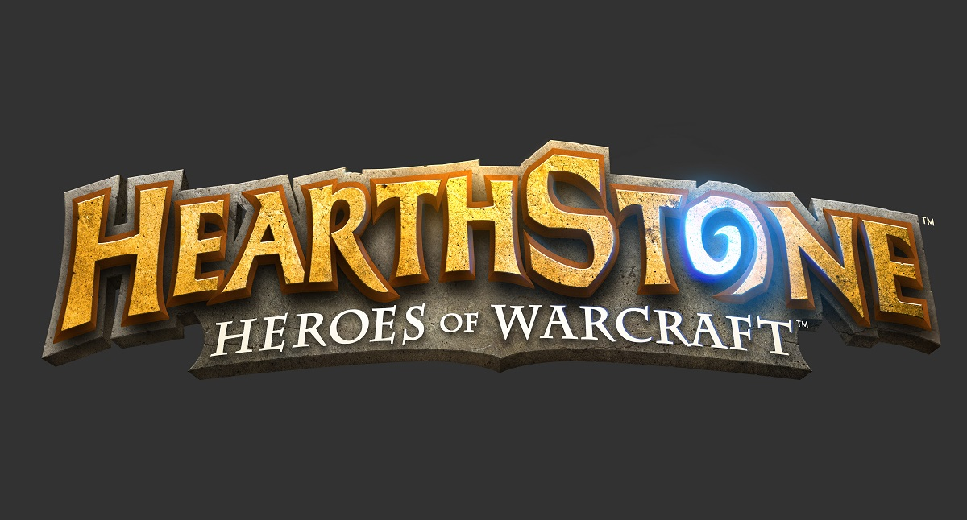
Hearthstone’s Lack of a Marketplace
Within Hearthstone, the only ways to obtain cards would be:
Buying Packs with cash
Earning gold in game by playing matches
In the Arena Mode:
Entry free with possible rewards for winning

Slide 8

Artifact: Trying something new
In order to be competitive with Hearthstone, Artifact decided to add one of the highly requested features of Hearthstone, an online marketplace
This marketplace is somewhere players could go to buy or sell cards with other players

Slide 9
Goals:
Perform web scraping to build and update a database containing pricing information for the cards
Use the database to build visualization tools from this pricing information
Develop “triggers” for interesting events that occur
Design with the intent of future scalability

Slide 10
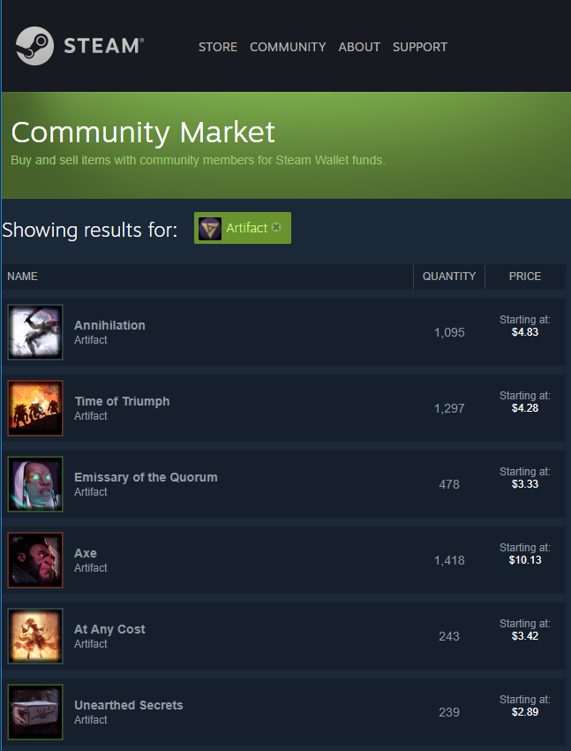
Example of Artifact Marketplace

Slide 11
Artifact Card Pricing Data
In order to keep an updated log of the prices of the different cards, we query the Steam Community Market to access the values

Slide 12
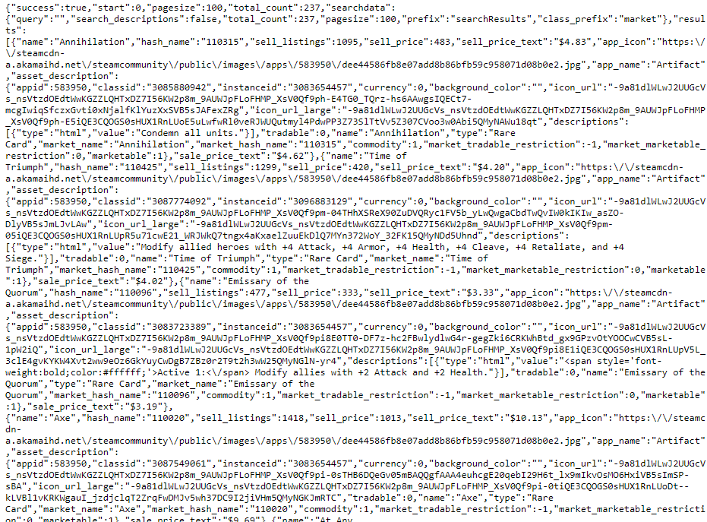
Accessing Webpage Data
We send get requests and receive the following JSON
Web request returns:

Slide 13
Two stages for parsing the data
Get a list of all of the cards and their “market hash”
Visit each individual page and access the data

Slide 14
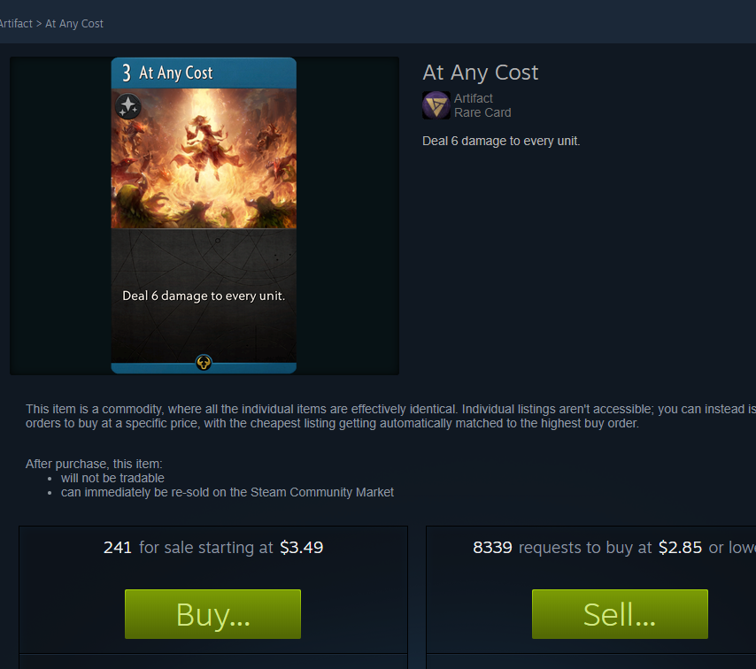
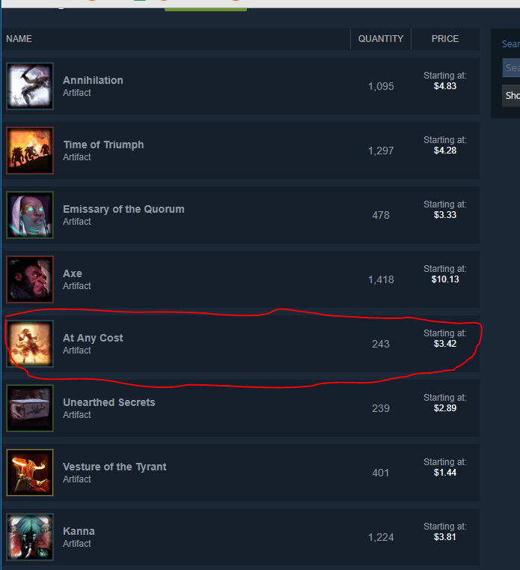
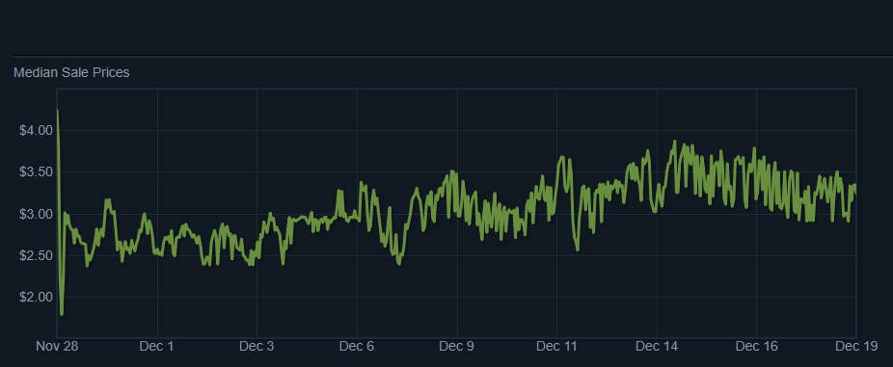

Slide 15
Designing for Scale
Currently there are ~250 cards in the game
A similar game (also made by the lead developer) currently has ~20,000 cards

Slide 16
Solution: Multithreading
And
SQL Database
Our goal is to create tools that will continue working as the game continues to grow
With multithreading we are able to take advantage of latency hiding to make sure that processors stay busy while waiting for the 250+ web requests
With an SQL database we are able to continue adding tables as the game releases more sets, scaling as the game grows

Slide 17
Storing the Data:
SQL Database
Two Database designs were investigated
Design 1: Full information
One table holds all card information: Name, Color, Rarity, Set Name
Each card has a corresponding table containing price history
Design 2: Reduced information
A single table for each set contains price history across each Rarity/Color combination

Slide 18
Design 1:
Pros and Cons
Pro:
Total information allows for more possible applications
Con:
Extra complexity
With design 1 we have to use threading for the queries due to doing O(NumCards) number of database updates

Slide 19
Design 2:
Pros and Cons
Pro:
Simplified database structure
Cons:
Lack of information about individual cards
Requires more preprocessing

Slide 20
Design Choice:
Design 2
We used design 2 as the database scheme our tools interact with but have worked on design 1 implementation
Design 1 implementation is close to complete but the rest of the tools would need to be changed to interact with the different structure

Slide 21

Reading from our Database
In order to access data from our database, we used a multiprocess python script in order to query our database and to display our graphs
We will expand on python multiprocessing vs multithreading on the following slides

Slide 22
Multithreading in python
Many scripts relating to network/data/IO spend the majority of their time waiting for data from remote sources. So for non CPU intensive processes, the processor can get data in parallel and simply combine it at the end
The problem with python threads is that only one can run at a time due to the GIL (Global Interpreter Lock)

Slide 23
Python Multithreading
Python only allows for one thread to run at a time since it is not a thread safe programming language
Thread 1:
Thread 2:
Thread 3:
Running
Running
Running
Running
GIL Release then Lock
GIL Release then Lock
GIL Release then Lock

Slide 24
Python Multithreading
This does allow for latency hiding however. For example, if one thread is waiting on a response from a network
This is the main speed up we get in our database loading process
Waiting for network data
Do calculations on data
Query Network
Thread 1:
Thread 2:
Thread 3:
Other Task
Other Task
GIL Release then Lock
GIL Release then Lock
GIL Release then Lock

Slide 25
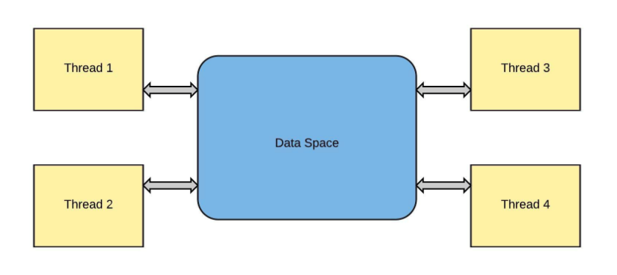
Multithreading in python
In python, you have access to generating processes and threads.
Threading comes in handy when you want additional processing power.
In python, threads cannot be used for parallel CPU computation, however, it is ideal for I/O operations such as web scraping because the processor is sitting idle waiting for data.

Slide 26
Multiprocessing in Python
Threading is not always the best solution.
Python programs have difficulty maximizing the CPUs resources when using multithreading
Multiprocessing allows you to create programs that run concurrently and bypass the GIL that python imposes

Slide 27
Multiprocessing in Python
Multiprocessing addresses the problem that multithreading in python brings up: it can utilize all of the cpu resources
Python Multiprocessing is inherently different from threading because each process is given its own memory space
This requires the different processes to use Message Passing in order to communicate information between them

Slide 28
Multiprocessing in Python
We run different processes on a different instance from the data collection
These processes perform functions such as:
Display graphs that visualize data (multi - threaded as well)
Perform pack evaluation and compute whether it is worth purchasing
Send out alerts based on pack evaluation to user

Slide 29
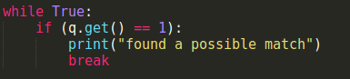
Sharing memory between processes
Python uses a queue data structure to allow for message passing
We use message passing between the processes on the same instance to allow for our web server (frontend) to receive data from our back end

Slide 30
Use case: Automated Triggers
In order to allow for scalability, we created an automated trigger process which would notify users if we analyzed an interesting event that occured
We decided to use a process because as more users subscribe to our system, it could take a long time to message each of them individually
We use a separate process in order to allow other systems to run

Slide 31
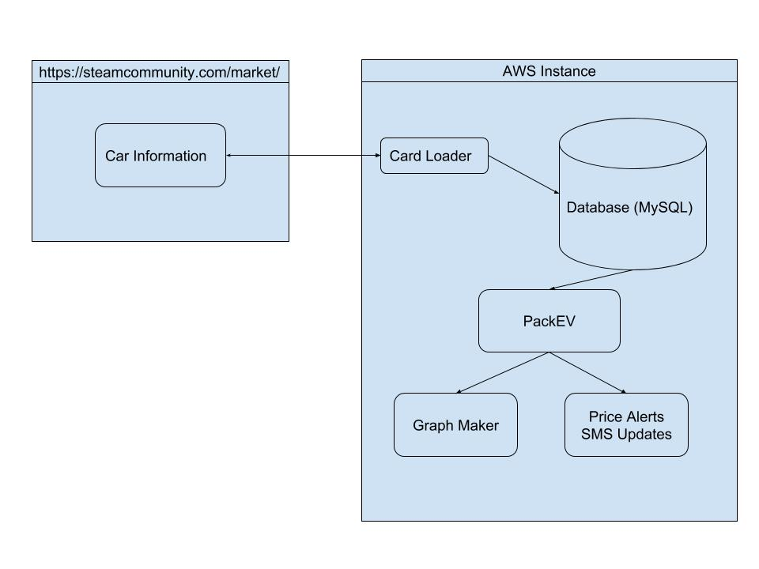
Simple System Diagram

Slide 32
Amazon Web Services
Our entire system is hosted through AWS
Our database uses Amazon’s Relational Database Service
Our processes run on two Elastic Container Service instances
Both provide tools to scale seamlessly

Slide 33
Packages Used:
Pandas
Used to easily read from our database and manipulate data
sqlalchemy
Provides tools to interact with SQL database
twilio
Send SMS alerts for when an interesting event occurs
matplotlib
Create graphs that represent the price of cards over time
Python Threading and Multiprocessing
Allow for a system that is not only fast now, but scalable for the future

Slide 34
Achievements
Created an AWS Database of card data for every hour from the past month
Created a multiprocess python script that reads from the database, alerts our users, and created graphs based on the data

Slide 35
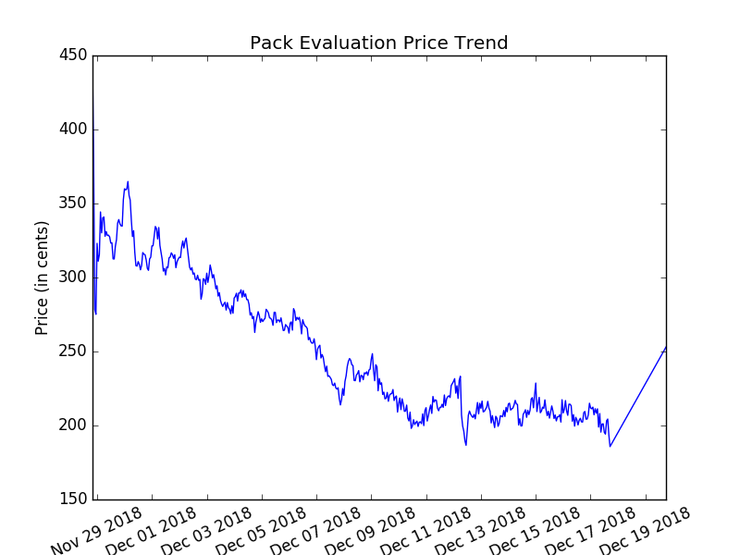
Trend Results
Graphs update every time database updates
Small gap in data due to database debugging

Slide 36
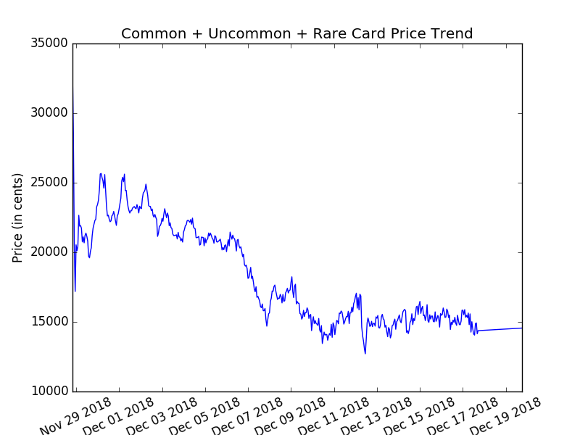
Trend Results
Graphs update every time database updates
Small gap in data due to database debugging

Slide 37
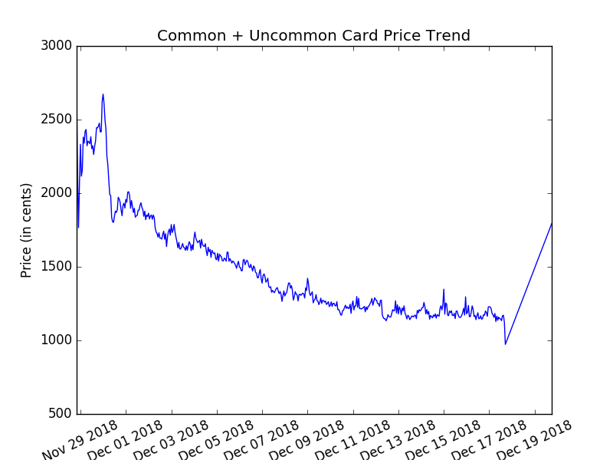
Trend Results
Graphs update every time database updates
Small gap in data due to database debugging

Slide 38
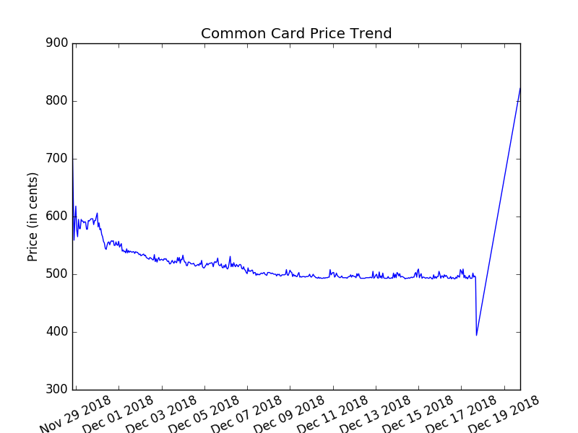
Trend Results
Graphs update every time database updates
Small gap in data due to database debugging

Slide 39
Future Plans
Learn Django (Python Web Framework) and create a fleshed out website to act as the front-end
Debug and implement database design 2 to work with current tools

